Slide 1


Red flags, real risk: What every broker needs to know
21st October 2026
Chloe Weatherill
Senior Enterprise Relationship Manager
Email: Chloe.Weatherill@ncino.com
Phone: 07738 096 078
Notes:
TIMING GUIDE (approx. 45 mins + Q&A): Welcome 2 | Opening - the data you can't see 5 | Red flags 20 | Reports 5 | Save time 5 | Compliance 5 | Wrap-up 3.
Welcome everyone and thank you to BIBA for hosting. Quick housekeeping: CPD certificate details are at the end, and please use the Q&A box throughout.
Set the scene: today is about spotting risk early - helping you focus your time, advise with confidence and stay compliant.

Slide 2



Learning Objectives
By the end of this webinar, delegates should be able to:
Define red flag indicators
Explore report insights
Analyse how to save time and focus effort
Explain how to support compliance with confidence
Notes:
By the end of this webinar, delegates should be able to:
1. DEFINE red flag indicators - understand how liquidations, CCJs and negative company history can signal risk, helping you quickly identify which prospects and clients need closer attention.
2. EXPLORE report insights - learn how to interpret report data to build a fuller picture of a company's financial stability and flag potential concerns early.
3. ANALYSE how to save time and focus effort - use risk signals to prioritise your pipeline, avoiding wasted time on high-risk opportunities and directing effort where it's most valuable.
4. EXPLAIN how to support compliance with confidence - apply risk insight to meet Consumer Duty and due diligence requirements, ensuring the advice you give is well-informed and defensible.

Slide 3

The Data Behind the Decision
Most risk signals never make the headlines
A company's website, reputation and day-to-day behaviour rarely show how it is really performing
Many of the strongest warning signs sit behind the scenes, or are scattered, delayed and hard to join up
Why it matters to brokers -
Risk is easier to manage when it is spotted early
Material Facts are disclosed to the Underwriter
Changes in payment behaviour and filing habits often appear well before a formal failure
The aim is not to avoid risk, but to see it clearly and advise accordingly
The Missing
Picture
Notes:
OPENING (2-3 mins). Keep this about what the data MEANS, not what we sell.
Talking points: When you meet a prospect or review a client, what you can see from the outside - the website, the premises, the reputation, even the meeting itself - is often a very polished version of the truth.
The warning signs tend to be quieter: late payments, court judgments, a director who has been involved in previous failures, accounts filed late or not at all.
The theme for today: red flags are prompts for better questions, not verdicts.
Talk about Claims here – ensure right risk on cover in first place so no issues. Claims being the shop window – If goo at looking after claim that client will stay so not competing on Premiums
BIBA Tour of the regions – Talk about claims – Insurance act 2015 – consumer duty regulatiions – Duty of disclosure – If underwriter receives info that is incorrect and would have accepted but higher – can reduce claim or can cancel policy and refund premium – if deliberate can cancel and keep premium. As a broker, creates mistrust with Broker. Consumer duty takes a little pressure off on that – but still important

Slide 4

Public Record vs. The Full Picture
Why the signals brokers need are so hard to see
What you can see from the outside
A company name, an address, a website and - if you go looking - filed accounts that can be many months out of date.
What sits behind it
Payment behaviour, county court judgments, directors' track records, filing patterns and credit indicators - drawn from many sources and joined up into one view.
Notes:
KEY MESSAGE (2 mins): Some of this information is technically public - Companies House, The Gazette, the Registry of Judgments - but it is spread across different places, often delayed, and only meaningful when you join it up and look at it over time.
Behind the scenes there is a much richer picture: how reliably a company pays its suppliers, whether judgments have been registered against it, who its directors are and what happened at their previous companies, and how its behaviour is changing.
Not too salesy: don't mention products here. The point is - this is the data that tells you whether to lean in or ask more questions.
OPTIONAL: Quick poll - 'How do you currently check the financial health of a new prospect?'

Slide 5





Red Flag Indicators
Liquidations
& Insolvency
CCJs
(Judgments)
Director
History
Company
History
Credit Report
Insights
Notes:
OVERVIEW (1 min). Five lenses we will work through - each one tells part of the story, none tells the whole story.
1. Liquidations & insolvency - formal failure or distress
2. County Court Judgments - unpaid debts that have gone to court
3. Adverse director history - the people behind the company
4. Negative company history - patterns of behaviour over time
5. Credit report insights - how it all joins up
Set expectations: we'll cover what each one is, what it can signal, and what questions to ask next. Use your real-life examples from slides 13 and 14 to bring these to life.

Slide 6
Red Flags: Liquidations
When a company is being wound up
Liquidations
Liquidation is the formal process of closing a company and distributing its assets to creditors
The main types to know -
Creditors' Voluntary Liquidation (CVL)
  Directors choose to wind up an insolvent company
Compulsory liquidation
  Ordered by the court, usually after a creditor's petition
Members' Voluntary Liquidation (MVL)
  A solvent company closing in an orderly way - not a red flag in itself
Notes:
LIQUIDATIONS (3-4 mins).
Talking points:
- A liquidation is the end of the road, but the signals usually appear earlier: winding-up petitions, administrator appointments, notices in The Gazette.
- Important nuance: not all liquidations are equal. A Members' Voluntary Liquidation is a solvent closure - often retirement or restructuring - so context matters.
- For brokers: a client or prospect in or near insolvency affects premium payment risk, continuity of cover and your own exposure.
- Questions to ask: What type of process? Who is involved? Is the business still trading? Are there connected companies?
[ADD YOUR REAL-LIFE EXAMPLE HERE - e.g. a prospect that looked healthy until a petition was found]

Slide 7
Red Flags: CCJs
What a CCJ tells you about payment
County Court
Judgments
A County Court Judgment (CCJ) is a court order requiring a business to repay a debt
What to look at -
Number and value
  One small, old judgment is very different to a growing pattern
Recency
  Recent judgments say far more than historic ones
Satisfied or outstanding?
  Unpaid judgments can point to ongoing cash pressure
Notes:
CCJs (3-4 mins).
Talking points:
- A CCJ means a creditor took the business to court, won, and the business was ordered to pay. It is a direct window into payment behaviour.
- Look beyond 'does it have one?' - consider number, value, how recent, and whether they have been satisfied.
- A CCJ is a symptom: the useful question is what is behind it. A disputed invoice is very different to cash-flow strain.
- Note: CCJs apply in England and Wales; Scotland and Northern Ireland have equivalent systems (decrees and the Registry of Judgments respectively) - worth a mention if you have delegates in those regions.
[ADD YOUR REAL-LIFE EXAMPLE HERE - e.g. a client with a cluster of recent CCJs]

Slide 8
Red Flags: Director History
The company is only half the story
Adverse Director
History
A healthy-looking company can still carry risk through the people running it
Signals worth knowing -
Previous directorships in failed companies
  One failure can happen - a repeating pattern is different
Director disqualifications
  Check who is really in control of the business
Rapid changes of directors or company name
  Can be a sign of phoenix activity - a failed business reborn without its debts
Notes:
ADVERSE DIRECTOR HISTORY (3-4 mins).
Talking points:
- Companies fail for lots of reasons, and many directors go on to run successful businesses - so this is about patterns, not stigma.
- A new company with a clean record can look low risk, but the directors may have a history of insolvent companies behind them.
- Phoenix activity: a failed company's assets and trade continue in a new entity. Not always improper, but a prompt for questions.
- Disqualified directors should not be acting in management of a company - worth knowing if someone else appears to be 'in the background'.
[ADD YOUR REAL-LIFE EXAMPLE HERE - e.g. a new company whose directors had previous failures]

Slide 9
Red Flags: Company History
Behaviour over time tells its own story
Negative Company
History
How a company has behaved over time can be a stronger signal than any single snapshot
Warning signs include -
Late or missing accounts and confirmation statements
Compulsory strike-off notices
Frequent changes of name or registered address
New or growing charges against company assets
Falling net assets or accumulating losses
Notes:
NEGATIVE COMPANY HISTORY (3-4 mins).
Talking points:
- This is the 'trend' view. Late filing, strike-off warnings and frequent changes show a business that may be struggling to keep its house in order.
- Charges (secured borrowing) matter because they show who else has a claim on the company's assets.
- Again: single events can be innocent. Several together over a short period is where it gets interesting.
- Link back to the broker's world: administrative slippage often shows up alongside late premium payments or missed renewal information.
[ADD YOUR REAL-LIFE EXAMPLE HERE]

Slide 10
Report Insights
Credit score and recommended limit
A quick view of how the company compares for risk - a starting point, not the full answer
Payment behaviour and trends
Is it paying on time - and is that getting better or worse?
Financial health
Net assets, cash, liabilities and profitability from the latest filed accounts
Flags and notices
Liquidations, CCJs, charges and director alerts brought together in one place
Report
Insights
Notes:
REPORT INSIGHTS (5 mins).
Talking points:
- This is where the individual flags get joined up. A report gives you a fuller picture of financial stability in one place.
- Walk through the four building blocks: score and limit, payment behaviour, financial health, flags and notices.
- Encourage delegates to read the trend, not the snapshot: a mediocre score that is improving may be a better prospect than a good score that is falling.
- Remind them that the score is a view of risk, not a recommendation - their judgement and knowledge of the client still matter.
[OPTIONAL: Show an anonymised report screenshot here and walk through where each flag appears.]

Slide 11



One Flag or a Pattern?
A single flag is a prompt for a conversation - several together are a pattern
Green
Low concern
Amber
Look closer
Red
Proceed with care
Clean record and healthy payment behaviour. Carry on as normal.
One or two flags, or a worsening trend. Ask more questions and dig deeper.
Multiple or recent flags. Escalate, adjust your approach and record your reasoning.
Notes:
PATTERN VS SINGLE FLAG (3 mins).
Talking points:
- This is the practical bit: how do you turn flags into action?
- Green: nothing of concern - business as usual.
- Amber: one or two flags, or a trend moving the wrong way. Don't walk away - ask better questions: what happened, when, and what has changed since?
- Red: multiple or recent flags together. Escalate internally, think about how you structure cover and payment terms, and document your reasoning.
- The point: the goal is not to say 'no' to risk, it is to make sure you are going in with your eyes open.
[ADD YOUR OWN EXAMPLE: one amber case that turned out fine and one that did not]

Slide 12

Compliance & Due Diligence
Well-informed advice is defensible advice
Defensible
Advice
Risk insight helps show you've considered your customer's circumstances before you advise
Where it supports you -
Consumer Duty
  Evidence you have considered customer needs and acted to deliver positive outcomes
Due diligence
  A documented, repeatable check on who you are dealing with
Audit trail
  A record of what you knew, when - and how you responded
Notes:
COMPLIANCE (3-4 mins).
Talking points:
- Good outcomes start with understanding the customer. Risk insight helps you demonstrate that you looked at the whole picture, not just the headline.
- Due diligence is about being able to show a consistent, repeatable process - not about checking everything on everyone.
- An audit trail protects you: if advice is ever questioned, you can show what you knew at the time and how you responded.
IMPORTANT - CHECK BEFORE PRESENTING: Consumer Duty applies to retail customers, so how much applies to your delegates depends on their client mix (commercial vs retail/SME). Worth confirming the wording with your compliance team or BIBA so you are describing the scope accurately.
FCA – requires you to deliver positive outcomes that protect clients from financial harm.
Duty of Disclosure – Insurance act 2015! Before that major one 1906 -

Slide 13

Errors & Omissions
Small mistakes, big consequences
E&O
Errors and omissions (E&O) are mistakes - or things left undone - in the advice, placement or servicing of a policy that cause a customer a loss
Where they typically arise -
Wrong or incomplete information at quote or renewal
Cover that doesn't match the customer's needs
Disclosure duties not clearly explained
Missed deadlines, renewals or claim notifications
Advice and decisions that weren't recorded
Notes:
DEFINE THE TERM (2 mins).
Talking points:
- E&O is rarely dramatic. It is usually an ordinary slip - a sum insured that was never challenged, a disclosure duty that wasn't explained, a renewal that was missed.
- The impact is usually only discovered when the customer makes a claim, which is exactly when it matters most.
- Why now: client expectations are higher, regulation (especially Consumer Duty) asks firms to evidence good outcomes, and when claims are refused or reduced, customers increasingly look to their broker.

Slide 14



Who Feels the Impact?
One mistake can ripple through the whole distribution chain
Brokers
Insurers
Customers
Claims land first on the broker, alongside higher scrutiny and the cost of PI cover.
Disputed claims and a growing reliance on accurate data from the distribution chain.
Gaps in cover, reduced or declined claims and a loss of trust when it matters most.
Notes:
OVERVIEW (1 min). Three audiences, one chain: the customer buys through the broker, the broker places with the insurer, and an error at any point can end up as a cost for all three.
We will take each in turn.

Slide 15
Impact: Brokers
Where the claim often lands first
Brokers
When a customer's claim is reduced or declined, they frequently look to the broker next
What it means -
More PI claims, and costly ones to defend
PI premiums and terms that follow the claims cycle
  Insurers look closely at controls and claims handling
A higher bar under Consumer Duty
  Evidence positive outcomes - don't just assert them
Records can decide the outcome
  Weak file notes leave little room for a defence
Notes:
BROKERS (2-3 mins).
Talking points:
- Industry commentary has long noted that when insurers refuse or reduce claims, customers look to their broker.
- Broker PI premiums rose and some insurers cut capacity or left the market after a period of heavy claims; market commentary since suggests conditions have eased and capacity has returned - but insurers still care about controls and claims handling.
- Law firm commentary ahead of Consumer Duty anticipated broker claims following the familiar pattern of failure to take reasonable care and skill, framed by whether a good outcome was achieved.
- Practitioners also note that broker PI claims can be hard to defend where staff training and record-keeping are weak.
SOURCES USED FOR THIS DRAFT: Lockton (broker PI trends and market commentary); Kennedys Professional Liability Report 2023; Insurance Times coverage of broker PI. Please check for the latest market position before presenting.
[ADD YOUR OWN EXAMPLE if you have one.]
Talk track – Record BIBA and FCA doing a lot together – ifAll what it’s like if not on meeting notes not discussed, tif get audited by FCA this is most important. Look can just download and upload but doesn;’t show what you’ve done and flagged which parts important – so show you have actioned it!

Slide 16
Impact: Insurers
Accurate data is the foundation
Insurers
Insurers depend on accurate information from the distribution chain - when it is wrong, the cost shows up in claims and complaints
What it means -
Pricing and risk selection built on weaker data
  Wrong sums insured or trading details distort the risk
More disputed and reduced claims
  Gaps between what was declared and what is found
Greater regulatory attention on the whole chain
  Consumer Duty looks at outcomes across intermediaries too
Notes:
INSURERS (2-3 mins).
Talking points:
- Underwriting and pricing are only as good as the data coming in. Mistakes at the point of sale come back as claims disputes and complaints.
- Consumer Duty applies across the distribution chain, so insurers and brokers share an interest in good outcomes.
- Regulators have also been focused on insurers' claims inflation and reserving - another reason accurate information at the start matters.
- The FCA has reportedly consolidated its sector expectations into a single Insurance Regulatory Priorities report in 2026 - worth checking the current wording before you cite it.
This slide is more inference than statistic - adjust to your own view of the market.
Talk track – Claims is your shop window! Moment in time insurance matters, premium is key consideratoration but businesses are more interested in those that ca provide positive sights and give th – Aggregators are a issue – AI problem – actually advantage as can compare policies better but compare focus on premium. Business directors care about claims and where can demo value – if set up incorrectly that’s where it falls apart.

Slide 17
Impact: Customers
The people who pay for the gaps
Customers
An error is often only found at the worst moment - when the customer claims
What it means -
Underinsurance and gaps in cover
  Claims reduced or declined over inaccurate information
Financial and operational disruption
  Especially for SMEs, where a loss can threaten the business
Delays, complaints and lost trust
  In the broker, the insurer and insurance as a whole
68%
of brokers report an increase in claims being reduced or declined due to discrepancies
Aviva Broker Barometer 2026, as cited by Cardinus
Notes:
CUSTOMERS (2-3 mins).
Talking points:
- The customer carries the loss. Often they don't know there is a gap until they claim.
- Soft-market conditions in buildings insurance have continued into 2026, which makes it tempting to keep renewals simple - but lower premiums don't lower rebuild costs.
- The stat on this slide comes from the 2026 Aviva Broker Barometer, as cited by Cardinus. Please check the original report to confirm the exact context (I read it as relating to discrepancies such as underinsurance) before presenting.
[ADD YOUR OWN EXAMPLE: a customer who found out at claim stage.]
Operational talk track – business interruption cover – BIC – Lost profit wand increased cost of working whilst the business can’t operate because of a insurable incident. E.g warehouse burns to ground and can’t manufacture – so could get new premise or cover that gap. Understanding finances at that point is key. Jaguar Land rover – cyber attack that shut them down for two weeks – May not just come from own business but understand whole supply chain can make you stand out. E.g supplier has issues or your customer is no longer purchasing because of theres – that business disruption can cover that. Actually CFC Have got an extension to their cyber policy – so for example JLR all these small business that only support JLR lost prevalent customer – can get this extension to cyber cover – that will cover if happens at customers/ suppliers – if want to know more BIBA have a scheme right now to cover this. – check how much cost UK economy! Key here JLR survived but if that were to happen to SME business

Slide 18
Reducing E&O Risk
Better data, records and conversations
Prevention
Practical steps -
Get the data right at source
  Verify company details, trading status and financials at quote and renewal
Explain, don't assume
  Make sure customers understand disclosure duties and policy limits
Record advice and decisions
  A clear audit trail is your strongest defence
Monitor through the policy lifecycle
  Changes in a customer's circumstances can create new gaps
Notes:
PREVENTION (2 mins).
Talking points:
- Most E&O is preventable with good data, clear conversations and good records.
- This links straight back to the red flags session: verified company information and risk signals help you ask better questions early.
- Insurers tend to look more favourably on brokers who can show proactive claims-management and risk controls (Lockton commentary).
- Close with the message: the aim is not to eliminate every error, but to make them rarer, spot them sooner and be able to show how you responded.

Slide 19
Save Time, Focus Effort
Put your time where it's most valuable
Smarter
Prioritisation
Risk signals help you sort your pipeline before you invest hours in it
How brokers can use them -
Screen prospects early
  Check new leads before the first meeting, not after the quote
Prioritise the strongest opportunities
  Healthy, growing companies first - higher risk needs a different approach
Monitor existing clients
  Hear about changes as they happen, not at renewal
Notes:
SAVING TIME (3-4 mins).
Talking points:
- Every broker has a limited number of hours. Time spent chasing a prospect that cannot pay, or that may not exist in six months, is time taken from the ones that can.
- Screen early: a five-minute check before the first meeting can save a week of wasted effort.
- Prioritise: not every high-risk company is a 'no' - but it may need different terms, payment structure or additional information.
- Monitor: risk is not a one-off check. Changes in a client's profile are often the earliest sign you need to talk to them.
[ADD YOUR REAL-LIFE EXAMPLE: e.g. a pipeline review where flags changed the priority list]
Moniotr – Talk track – if something changes and proactive – tmaking changes midterm – saves your renewal from attack

Slide 20
Real life examples

Slide 21

Real-Life Example: A Missed Flag
A broker customer story from 2024
Real-Life
Example
What happened -
The audit process used a standard credit report, attached to the client's file
No adverse director history was flagged - so it was never disclosed to the insurer
When the client tried to claim, it was identified by Insurers that they had multiple adverse director histories for both directors
The insurer cancelled the policy
Run through screening instead -
The director flags were raised in the platform and stated clearly on the report
Notes:
REAL-LIFE EXAMPLE (3-4 mins).
Source: a 2024 broker customer story. The company and directors are anonymised on the slides - check you have permission before naming them or the broker.
Talking points:
- The broker did what many firms do: ran a standard credit report as part of its audit process and attached it to the electronic file.
- That report did not reference any adverse directorships for the directors. As a result, the history was not disclosed to the insurer.
- When the client came to claim, the insurer cancelled the policy because of the non-disclosure.
- When the same company was later run through screening, the information was 'unmissable': it raised flags in the platform and was set out clearly on the report.
Pause point: ask delegates 'If this was your client, what would you have known - and when?’
Court Case related to insurance act – RSA insured factory – Claude – no adverse directory history – got away not paying – appealed – customer couldn’t afford to rebuild

Slide 22
What the Report Shows
Early flags, and the impact down the line
June 2020
Directors join
June 2023
Other firms fail
Sept 2026
In liquidation
Both directors join the company, alongside other directors.
Two of their other companies enter creditors' voluntary liquidation on the same day.
Resolutions to wind up and liquidator appointments are recorded against the company.
Today's report: 10 open flags, including adverse director history and serious adverse credit information
Notes:
WHAT THE REPORT SHOWS (3 mins).
Source: screening report generated 13 October 2026. Company and directors anonymised on the slide.
Facts from the report:
- Both directors were appointed to the company on 9 June 2020 (55% and 23% shareholders respectively).
- Both were also directors of two other companies (Parish Huddersfield Ltd and Parish Bars Ltd), which each entered Creditors' Voluntary Liquidation on 6 June 2023.
- The company itself now shows legal notices dated 3 September 2026: meetings of creditors, resolutions to wind up and voluntary appointments of liquidators. The latest event against the company is Creditors' Voluntary Liquidation.
- The report shows 10 open flags (25 rules run), including adverse events relating to other directorships (one for each director), adverse legal information in the last 120 months, and a Delphi band of 'serious adverse information'.
- Latest filed accounts (31 December 2024): working capital of (93K GBP), down 32.46% on the previous year, and negative shareholders' funds of (86K GBP). No judgments and no outstanding charges are recorded.
Talking points: the earlier failures were already history when the 2024 claim story played out - and the company has since followed the same path. The flags were early; the impact came later.
NOTE: the report header says 'Unfinished' and shows 94 adverse media listings. These are 'potential' name matches to unrelated entities (e.g. foundations, sports clubs), which is a useful reminder that flags are prompts for judgement, not verdicts - but you may prefer not to show that page.

Slide 23
Can I use this to my advantage?

Slide 24
Turning Near-Misses into Wins
A possible error can be your best advert
The
Opportunity
Undisclosed risk is a potential errors and omissions problem - for the customer first, and eventually for the broker who missed it
Two ways it plays out -
New business: find what the incumbent missed
  Show a prospect a gap they didn't know existed
Existing clients: find it before anyone else does
  Engage early, then speak to underwriters with full transparency
Notes:
FRAMING (2 mins).
Talking points:
- In the earlier section we looked at what happens when a flag is missed. This section flips it: what happens when it is caught?
- The same information that could become an E&O problem becomes a differentiator when you find it first and handle it well.
- Two examples: one new-business win from a prospect who was happy with their incumbent, and one existing client where early awareness led to a higher premium and a stronger relationship.

Slide 25
Turning Near-Misses into Wins
Keeping a client - and growing the account
The
Opportunity
What happened -
A client appeared in the local news over an HMRC penalty for underpaying staff, and didn't tell their broker
Automated news monitoring alerted the broker immediately
The broker spoke to the client to understand the full context, then briefed underwriters transparently
Terms were readjusted, securing an additional £6.5k premium
Notes:
FRAMING (2 mins).
Talking points:
- In the earlier section we looked at what happens when a flag is missed. This section flips it: what happens when it is caught?
- The same information that could become an E&O problem becomes a differentiator when you find it first and handle it well.
- Two examples: one new-business win from a prospect who was happy with their incumbent, and one existing client where early awareness led to a higher premium and a stronger relationship.

Slide 26
What Monitoring Showed
Speed and context preserved the relationship
Before
Self-reporting
The Alert
Caught instantly
The Result
£6.5k extra
Relied on clients to disclose material changes, and a client did not mention a public HMRC penalty.
Automated news monitoring flagged the article straight away, giving the broker the first move.
Full context and a transparent underwriter conversation kept the client and added premium.
Outcome: £6.5k additional premium, coverage gap prevented
Notes:
WHAT MONITORING SHOWED (2 mins).
Talking points:
- The gap here was not an error by the broker - it was reliance on the client to self-report. That is a very common process gap.
- Speed mattered. Being the first to know meant the broker could approach the client before anyone else did, and before the underwriter heard about it second-hand.
- Context mattered too: understanding the full picture turned a worrying headline into an informed underwriting conversation.

Slide 27
Example 1: The Undisclosed CCJs
Winning a switcher from an incumbent
New
Business
What happened -
The prospect already had cover and saw no reason to switch
A screening showed CCJs linked to one of the directors that hadn't been declared to their insurer
The broker explained how undisclosed information could put their cover at risk
The prospect switched, securing a £16k premium for the new broker
Notes:
EXAMPLE 1 (3 mins).
Source: customer story, 'Undisclosed CCJ Detection Wins £16k Switcher Through Risk Exposure'. Prospect and director anonymised.
Talking points:
- The challenge every new-business executive knows: prospects already have insurance and see no reason to switch.
- The prospect was comfortable with their insurer and unaware of any issue.
- A screening revealed CCJs linked to one of the directors that had not been declared to the existing insurer. The executive shared the finding and explained the potential consequences.
- The result: the prospect switched and the broker secured a £16k premium.
Optional quote from the executive (add name/photo only if permitted): 'Screenings give me valuable insights into the business to help me have conversations around CCJs and undisclosed risks.'
CHECK BEFORE PRESENTING: the story text refers to CCJs on a director, while the screenshot flag reads 'adverse events relating to other directorships'. Confirm which is accurate so the slide matches what you show. The story also says undisclosed CCJs could 'void' cover; I have softened this to 'put their cover at risk' because the outcome depends on the circumstances.

Slide 28
Spotting the Gap
From 'no reason to switch' to 'a gap I didn't know about'
Starting Point
Happy incumbent
The Finding
Undisclosed CCJs
The Result
£16k premium won
The prospect already had cover and saw no reason to switch.
CCJs linked to a director had not been declared to the existing insurer.
Seeing a coverage gap they didn't know existed, the prospect switched.
Outcome: £16k premium won, coverage gap identified
Notes:
SPOTTING THE GAP (2 mins).
Talking points:
- Notice the shape of the conversation: it did not start with a pitch on price or product. It started with something the prospect did not know about their own situation.
- That is what moves a prospect from 'comfortable' to 'I need to talk to you'.
- The insight came from a routine screening before the conversation - five minutes of preparation.

Slide 29
Why It Matters
Just one missed flag to Proactive Oversight!
Errors &
Omissions
Client Trust
Consumer
Duty
Information not passed to the insurer can leave a customer uninsured - and the broker exposed.
Oversight beyond the transaction showed value, keeps the relationship and find’s new business!
Where it applies: avoid foreseeable harm and help customers understand what they must disclose.
Notes:
WHY IT MATTERS (3 mins). Link back to errors & omissions, compliance and Consumer Duty.
ERRORS & OMISSIONS: Adverse director history is the kind of information an insurer may consider material. If it is missed and not disclosed, the problem usually surfaces at claim stage - exactly when the customer needs the policy most. For a commercial customer, the duty of fair presentation under the Insurance Act 2015 sits with the insured, and insurers' remedies for a breach can include avoiding the policy; the broker's role in helping the customer present the risk is where E&O exposure can arise. Please check this wording with your compliance team.
COMPLIANCE & DUE DILIGENCE: The question a regulator, insurer or PI underwriter will ask is 'what did you know, when did you know it, and what did you do about it?' A documented, repeatable screening step with flags actioned and recorded is a much stronger answer than a report that never mentioned the issue.
CONSUMER DUTY: The Duty applies to retail customers, so how far it reaches a commercial client like a restaurant depends on the facts and the firm. Where it does apply, it points firms towards avoiding foreseeable harm and supporting customer understanding - including making sure customers know what they need to disclose and why. Confirm scope with compliance or BIBA before presenting.
Close: this is the 'save time, focus effort' message from earlier - the flag was knowable early, and acting on it protects the customer, the broker and the insurer.

Slide 30
Key Takeaways
Red flags are prompts, not verdicts
Part of
the Story
Join the
Dots
Protect
Your Time
Record
Your Response
Liquidations, CCJs, director and company history each tell part of the story.
Reports bring it together - one flag is a prompt, a pattern is a warning.
Use risk signals to prioritise your pipeline and protect your time.
Record what you found and how you responded - it makes your advice defensible.
Notes:
WRAP-UP (2-3 mins). Recap the four learning objectives: we have defined the red flags, explored report insights, looked at how to save time, and covered how this supports compliance.
Close with the main message: red flags are prompts, not verdicts.

Slide 31
How nCino supports

Slide 32
Supporting the insurance industry’s biggest challenges
ACQUISITION
COMMIT
EXPANSION
Win the right customers
Keep for life
Increase new business by up to 80%.
Save 2.5 hours a week researching and engaging with customers
Reduce the cost to acquire
Howden (aston Lark) have achieved a 95% renewal retention rate across their portfolio – SmartBroker provides a consistent method across all the brands joining to group.
Accelerate Onboarding​
80% faster than average. By reducing time spent on manual portfolio checks, QBE have improved underwriting efficiency
Notes:
Now we’ve finished the introductions, we’ll give some background into what we understand about you and your existing challenges and objectives
Give an overview of FullCircl, our solution, the challenges we solve and our evaluation process
Then agree whether a further conversation around potential solutions to get you to your goal makes sense
Is that in line with your expectations for today?

Slide 33










At a Glance
600+ clients
84% in regulated industries
ABOUT US
270M connections
The richest and most up to date insight on UK and Irish companies
Trusted by the largest and newest
Banks, insurers & FinTechs,
Tech, Telco and Pro Services​
15,000+
Front and Middle Office Professionals
82% NPS
Clients love us
100% + Net Retention
Notes:
In July 2021 - Artesian and DueDil combined strengths to create a unique platform which now serves over 600 clients, 84% of which are in regulated industries
Over 15,000 front and middle office professionals use our software everyday in the largest and newest FSI institutions in the UK and I
We maintain exceptional customer retention levels and high NPS scores by using the richest and most up to date data and insight on UK and Irish companies
I will explain how we do this and why we are different in a moment

Slide 34
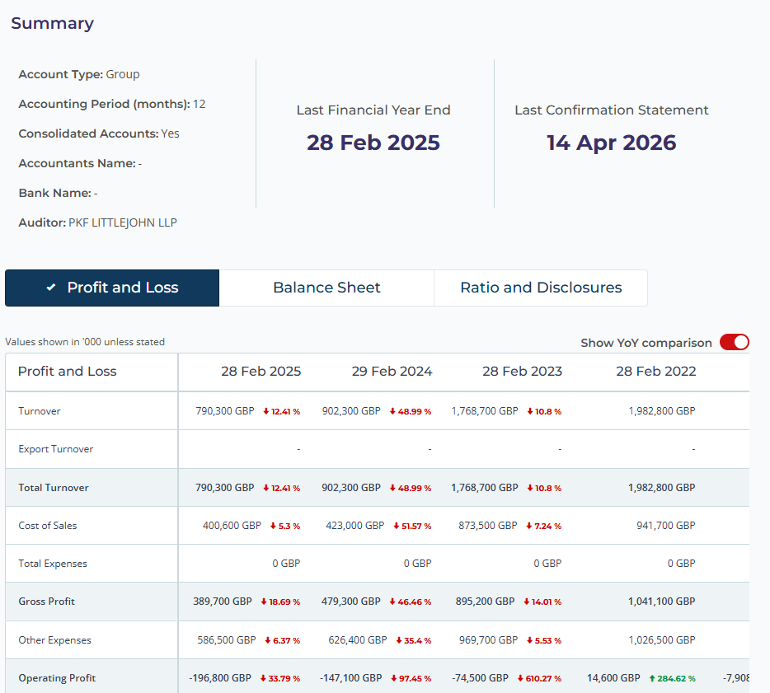
Company Data at a glance
We match and enrich information from over 30 official and third-party sources, providing the most comprehensive view possible.
Connected Financials
Our financial data can help you offer valuable expertise and guidance to your clients, quickly, fostering strong relationships and helping companies protect their economic well-being.
Family tree & Group explorer
National and international linkages provide valuable information when compiling the employee’s liability certificate.
Material Fact data
Quickly view data to help with your material fact questions including, adverse directorships and CCJ’s. Before you waste your time with the sales process and submitting quotes with incorrect data, just to be dismissed, know before you start the conversation.

Slide 35
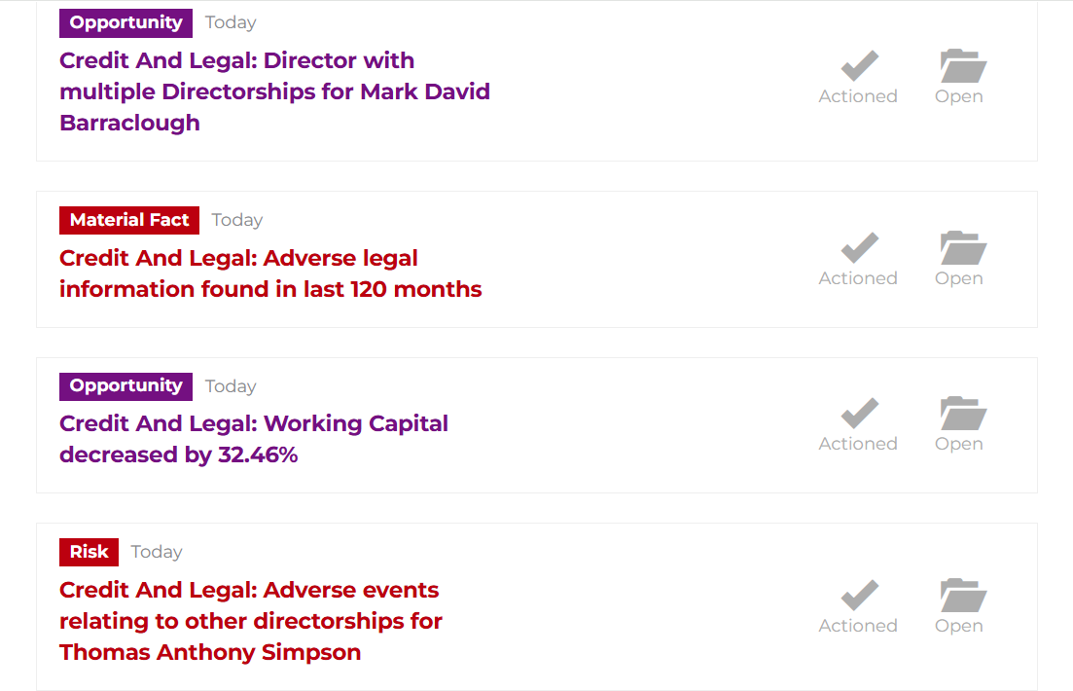
Flagging you to risks and opportunities
Our Propensity to buy Triggers identify potential exposures at companies, allowing you to have better, data-driven conversations. Getting weekly updates or alerts right after their accounts are submitted to make you aware of changes to act on immediately.
Pre-qualification screening with pre-configured checks:
Save time – quickly assess any risk associated with potential clients. With rules created in collaboration with BIBA and the biggest brokers in the UK, we can alert you of risk and opportunities in accounts, directors from risky countries to increases in gross profit, know exactly what to speak to your prospects about.

Slide 36
SmartBroker full feature list
Prospecting
Data
Pre-screening
Prospector tool | ✓
Company watchlist | ✓
Data exporter | ✓
Company profiles | ✓
Address | ✓
Company family tree | ✓
Timeline | ✓
Financials | ✓
Ownership | ✓
Company accounts | ✓
Mortgages & charges | ✓
People information | ✓
Group structures | ✓
HMRC import & export | ✓
Adverse directorships | ✓
CCJs & legal notices | ✓
Credit & risk | ✓
UBO | ✓
Pre-screen with a pre-configured rule-set designed for banking | ✓
Monitoring
News &
Social Media
Data change email alerts | ✓
Engagement signals and emails | ✓
Company newsfeed | ✓
News filters | ✓
Sector news / alerts | ✓
Social media | ✓
Administration
Training academy | ✓
Management reporting | ✓

Slide 37
nCino SmartBrokerTM + Acturis
A connected solution for brokers, insurers and MGAs providing meaningful opportunities to drive growth
Acturis and nCino are working together to provide users with rich
contextualised and connected company information.
Identify and win new customers
Populate Fields and Forms in
Acturis
Run screening and onboarding
checks
Track company events
Using SmartBroker, build a list of companies that match your key prospecting criteria before uploading to your Acturis platform using the Automation
module.
Save hours of re-keying by automating customer data collection from official and third-party sources like mainstream CRA’s, Companies House and the HMRC.
Automate processes to streamline your pre-qualification screening and onboarding journey for customers.
Free up the time you need to accelerate growth and reduce
customer acquisition costs.
Monitor a company’s progress and
proactively track changes that might
impact the associated risk and opportunities in real time throughout
the customer lifecycle based on your
predefined rules.

Slide 38
Learning Objectives
By the end of this webinar, delegates should be able to:
Define red flag indicators
Explore report insights
Analyse how to save time and focus effort
Explain how to support compliance with confidence
Notes:
By the end of this webinar, delegates should be able to:
1. DEFINE red flag indicators - understand how liquidations, CCJs and negative company history can signal risk, helping you quickly identify which prospects and clients need closer attention.
2. EXPLORE report insights - learn how to interpret report data to build a fuller picture of a company's financial stability and flag potential concerns early.
3. ANALYSE how to save time and focus effort - use risk signals to prioritise your pipeline, avoiding wasted time on high-risk opportunities and directing effort where it's most valuable.
4. EXPLAIN how to support compliance with confidence - apply risk insight to meet Consumer Duty and due diligence requirements, ensuring the advice you give is well-informed and defensible.

Slide 39
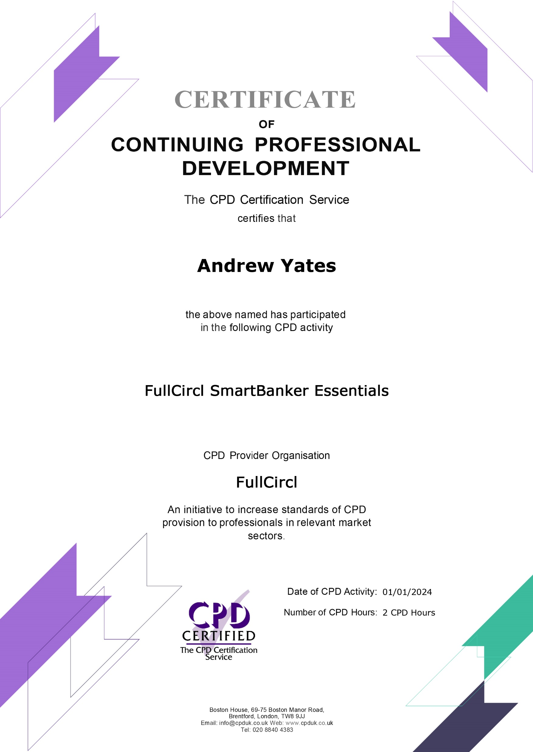

Next Steps
Understand Ecosystems
Create Bespoke Watchlists
Interest in nCino?
CPD Certification
Red Flags, Real Risk is just one of many course free to you as part of an nCino subscription.
If you want to discuss access to our platform or our API integrations for this data plugged into your systems, please reach out to myself after the session.
BIBA Facility Offer
25% discount off list price
Attractive multi-seat bundle
Dedicated Account team
CPD accredited training and full access to Academy
This training is CPD certified. To receive your certificate, please complete the feedback survey that will be sent to you by BIBA following the session.
Advanced Prospecting
Refining Your Newsfeed

Slide 40
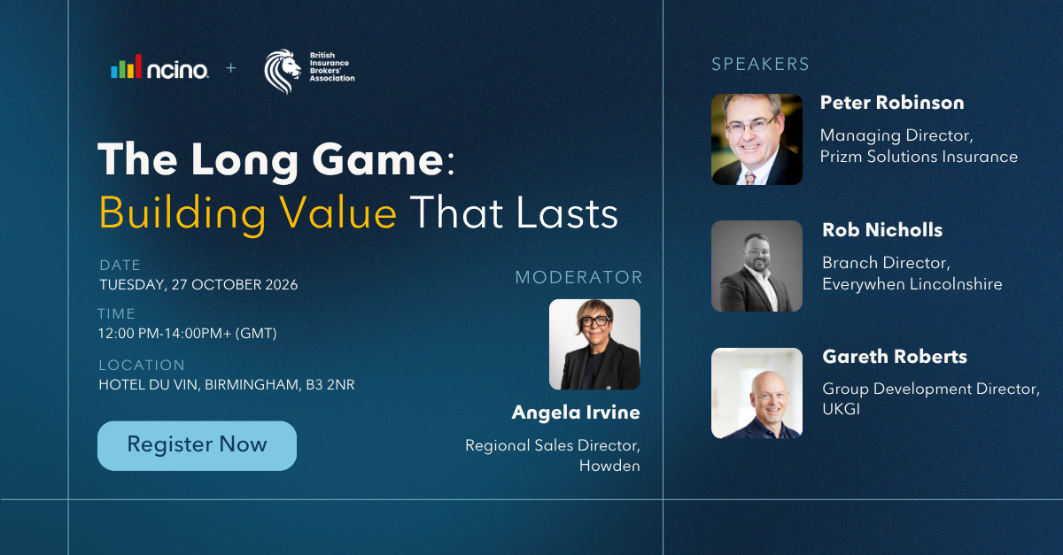
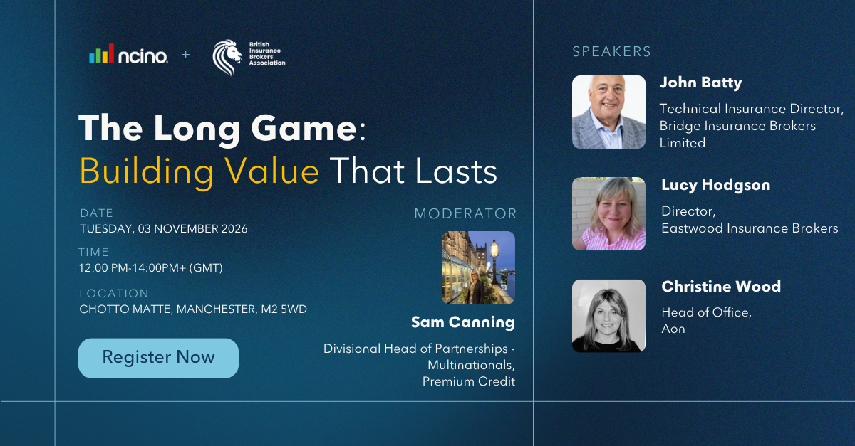
Interested in hearing more?
Join our expert panel to discover how nCino supports businesses of every size, from Large corporate to independent brokers
Birmingham
Manchester
Tuesday 27th October 2026
12pm – 2pm
Hotel Du Vin, Birmingham
Tuesday 3rd November 2026
12pm – 2pm
Chotto Matte, Manchester

Slide 41
Q&A
Chloe Weatherill
Senior Enterprise Relationship Manager
Email: Chloe.Weatherill@ncino.com
Phone: 07738 096 078

