Slide 1






Travel & protection insurance for people living with medical conditions
23 July 2026
www.biba.org.uk/find-insurance
1

Slide 2
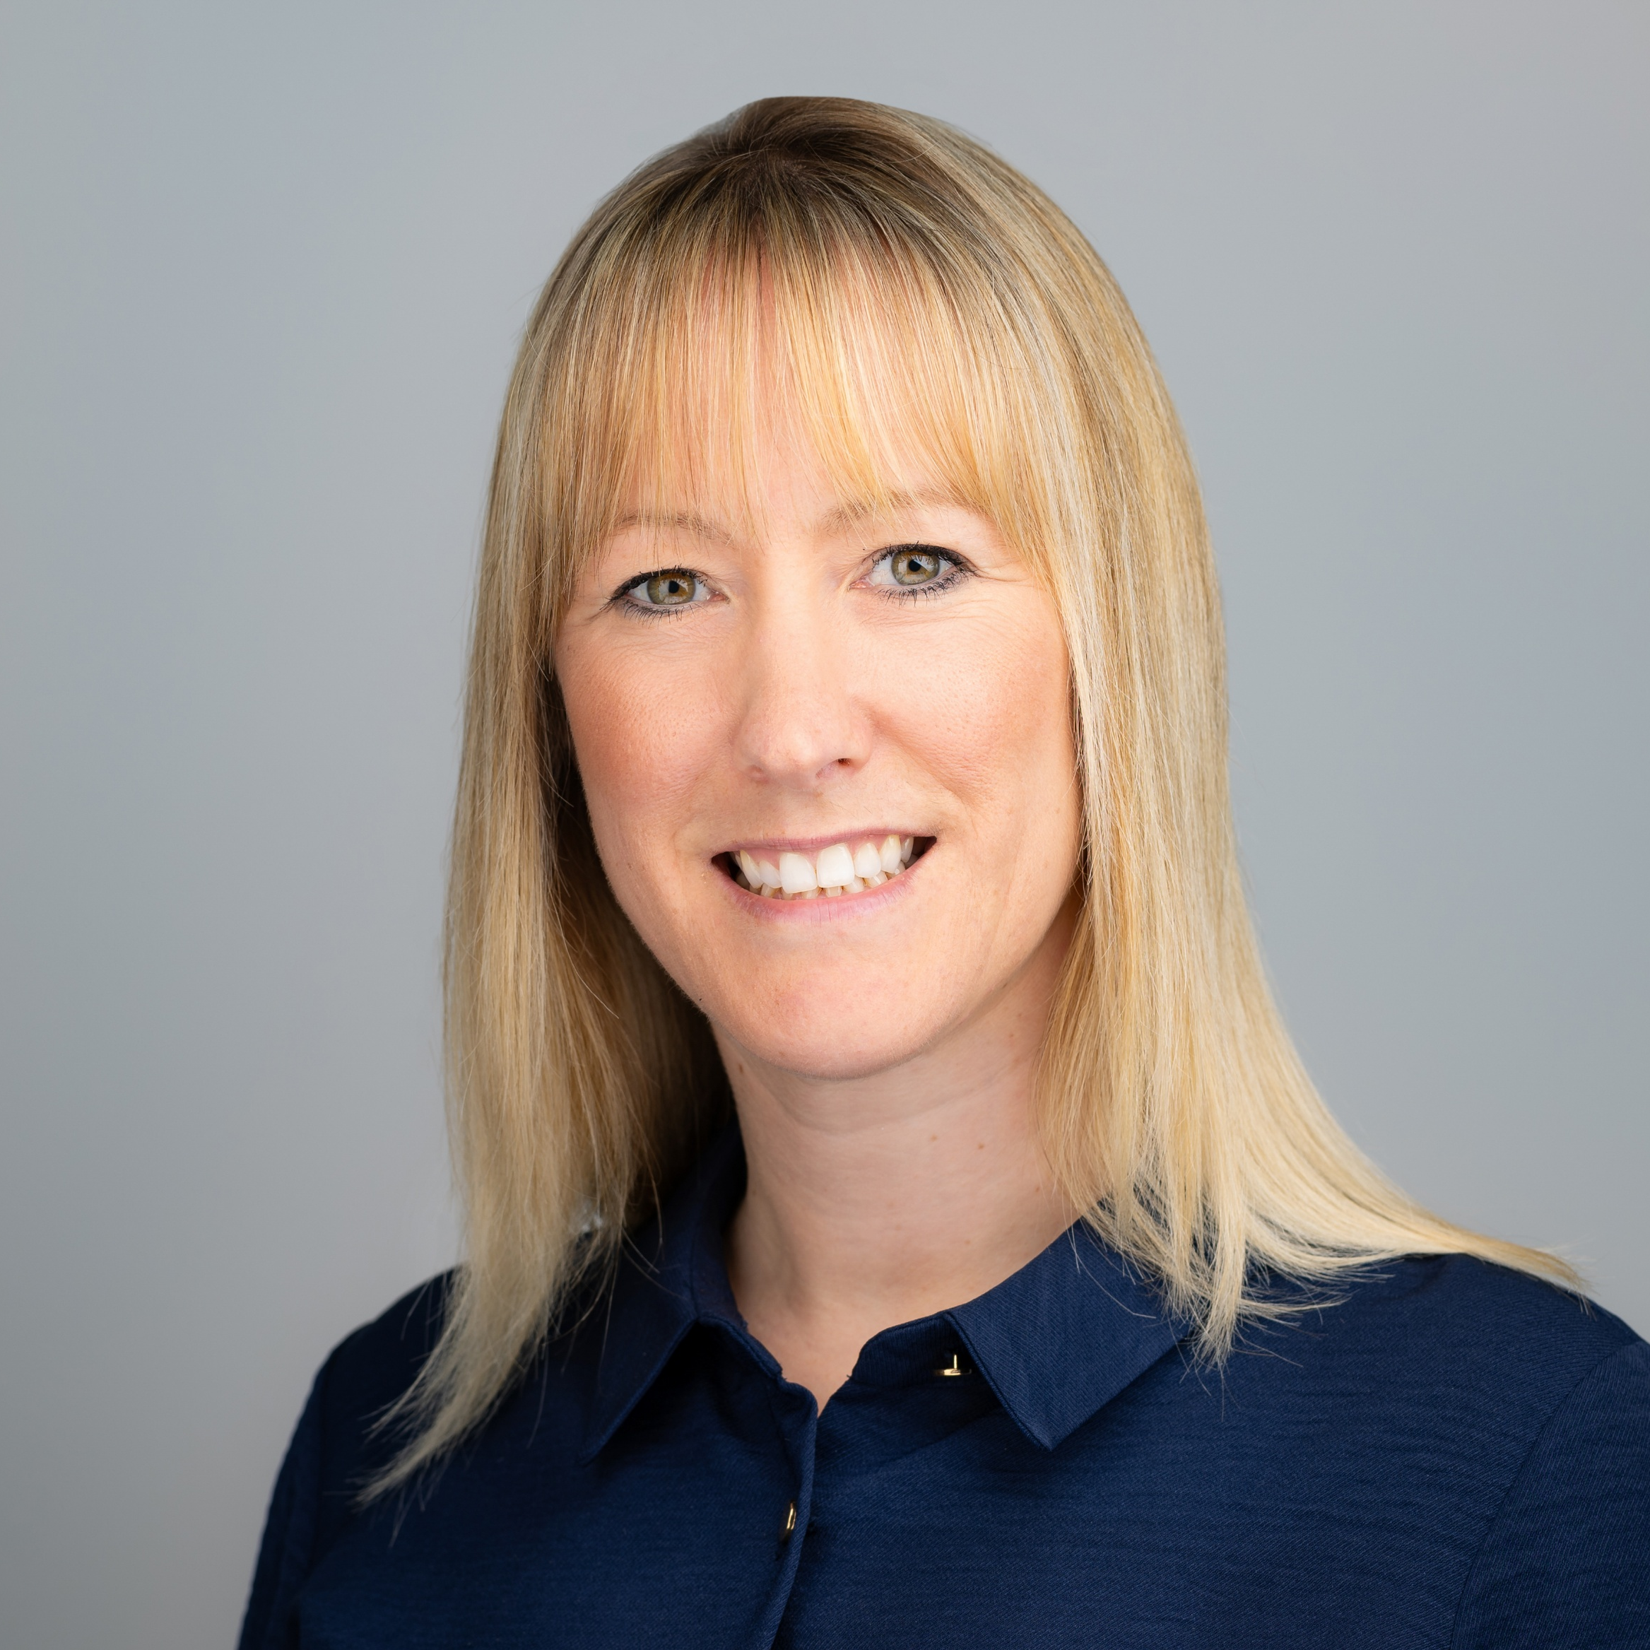
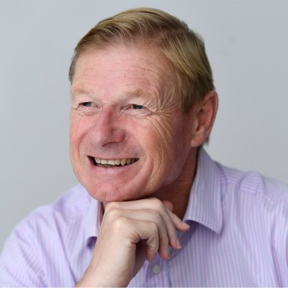
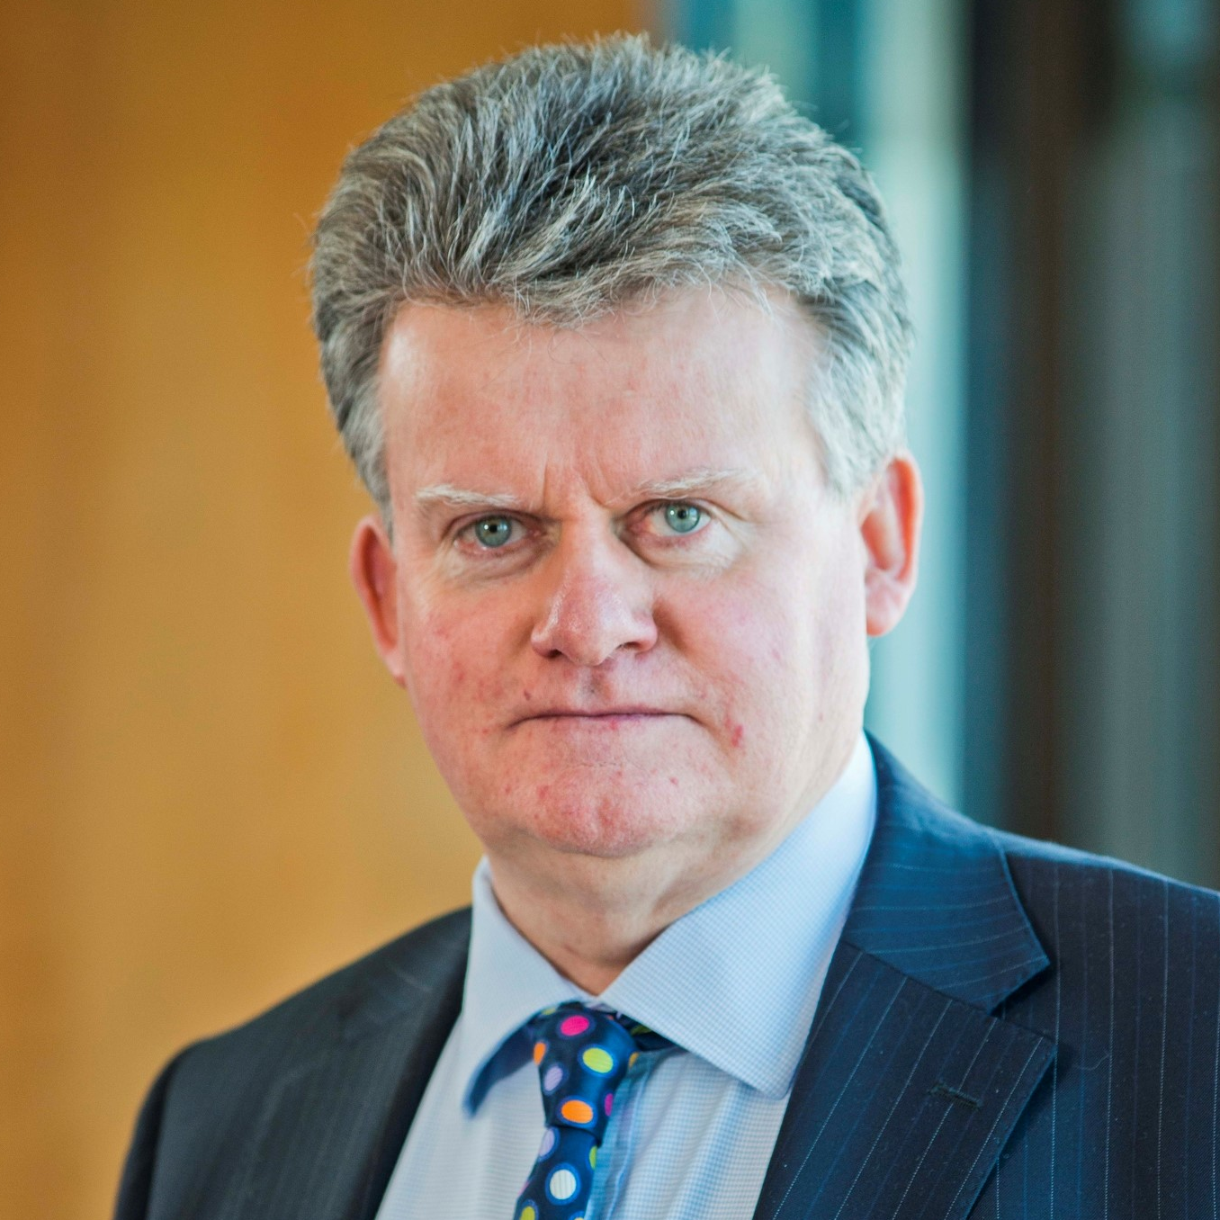
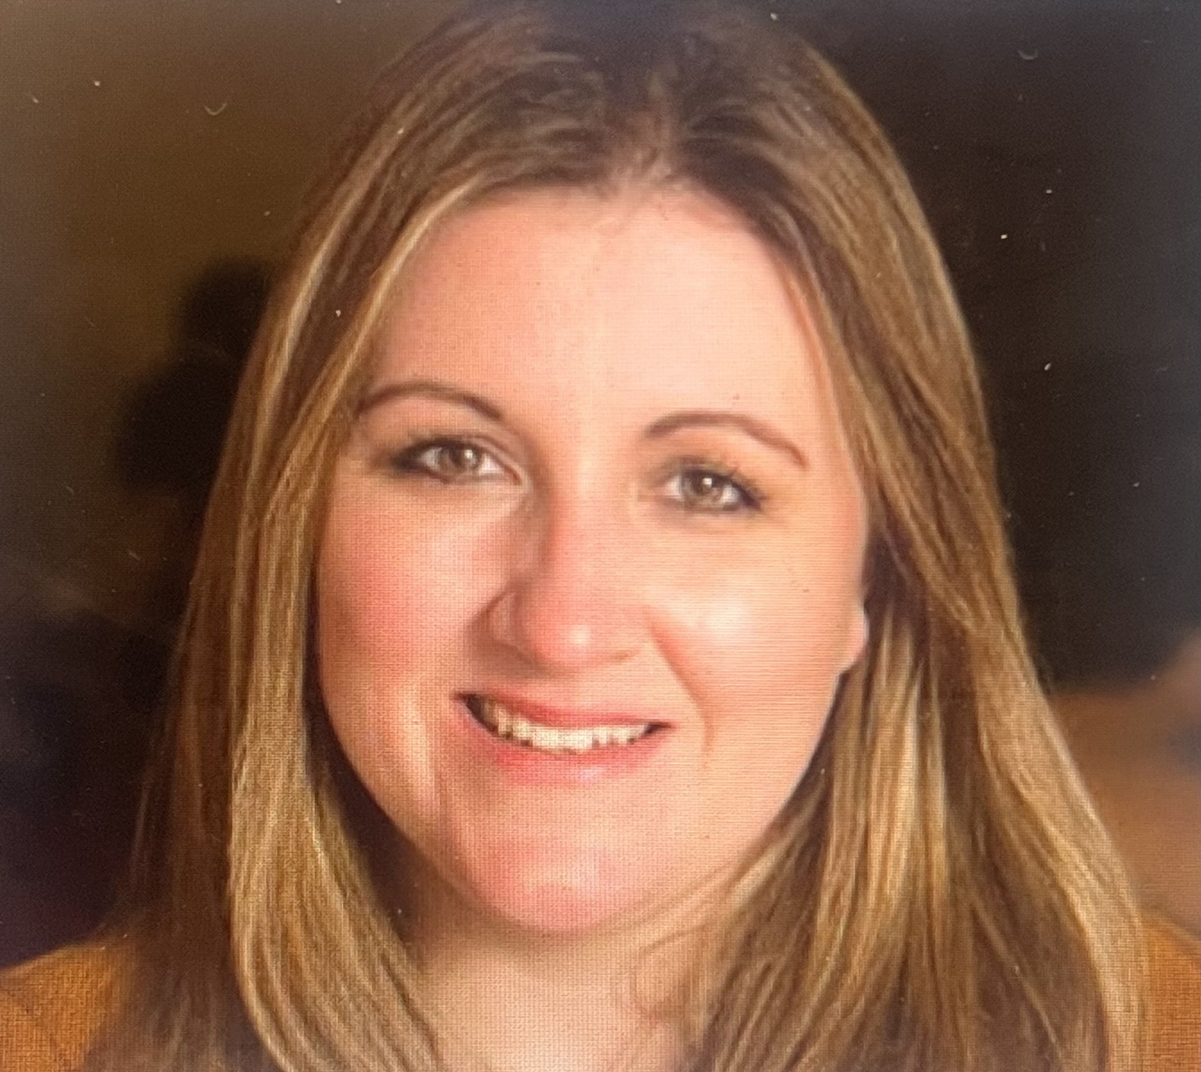
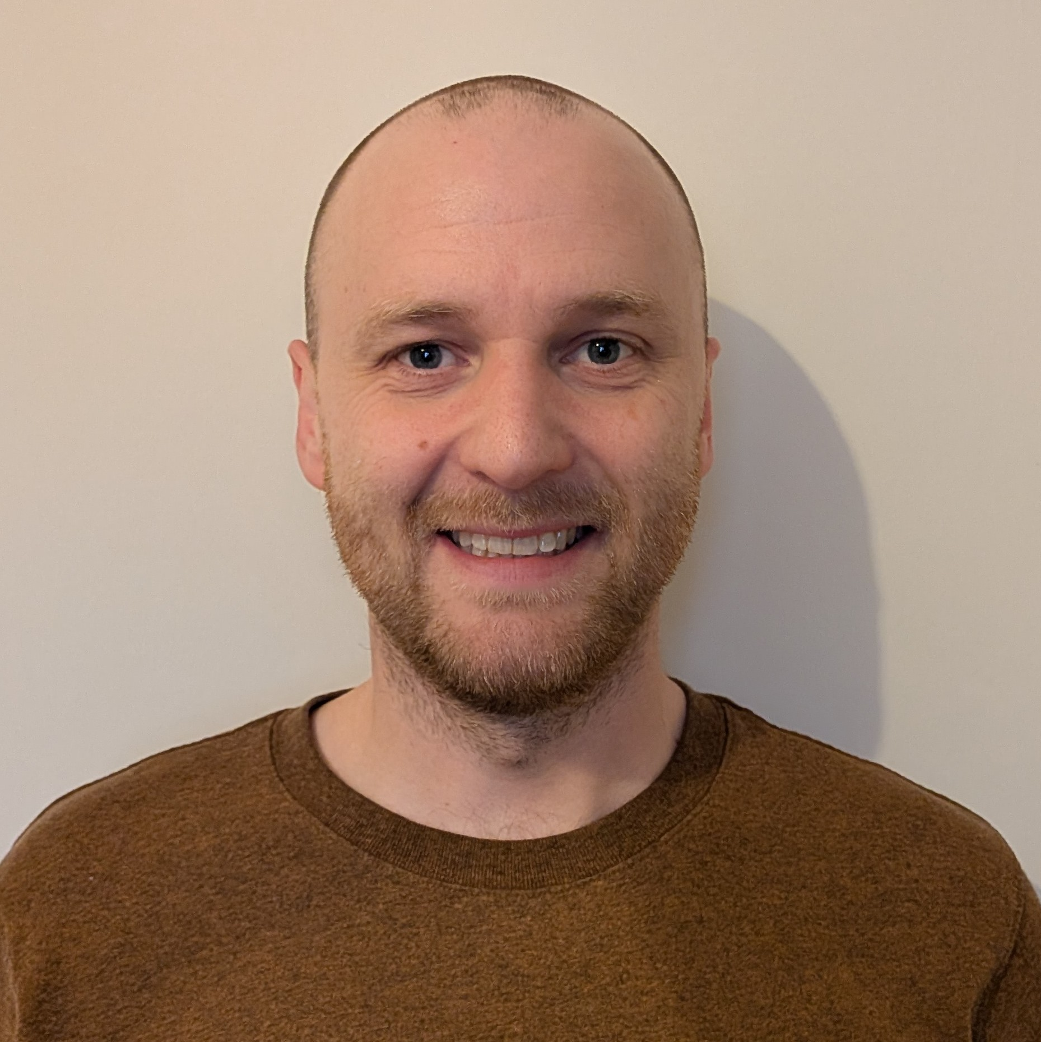
Introductions
Leighann Forsyth
BIBA
Garry Nelson
All Clear
Johnny Timpson OBE
Protection specialist & Financial Inclusion Commission
Charmaine Jagger
Co-Head Maggies Royal Marsden
David Whalley Partnerships Manager MND Association
www.biba.org.uk/find-insurance
2

Slide 3

About BIBA
&
Find
Insurance
Service
www.biba.org.uk/find-insurance
3

Slide 4
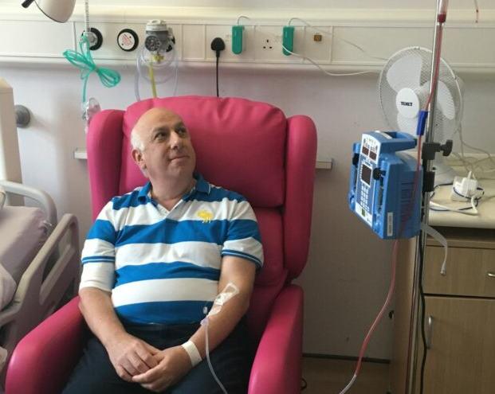

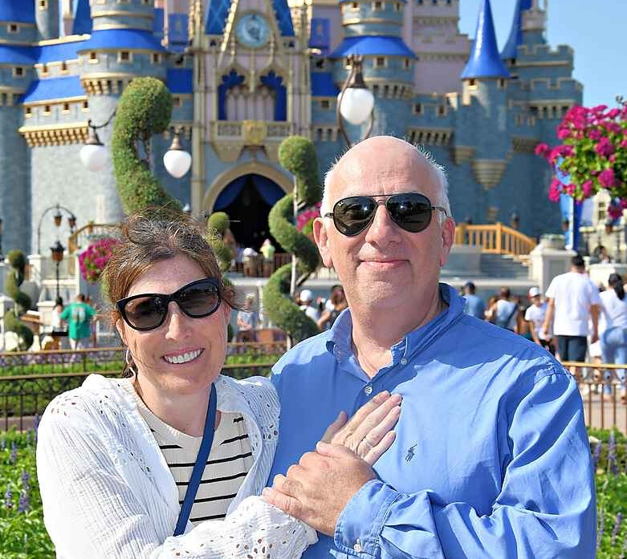
Case Studies
www.biba.org.uk/find-insurance
4

Slide 5


Importance of
travel insurance
What does travel insurance cover?
Why is it important?
www.biba.org.uk/find-insurance
5

Slide 6

Importance of
protection insurance
What is:
Life insurance
Critical illness
Income protection
www.biba.org.uk/find-insurance
6

Slide 7

How pricing
works
Ratings factors
Policy type
Age
Duration
Destination
(if travel)
Medical conditions
IPT
www.biba.org.uk/find-insurance

Slide 8

Challenges & how to
overcome them - Travel
Destination
Medical screening
Questions
Importance of disclosure
Specialist advice
www.biba.org.uk/find-insurance

Slide 9

Challenges & how to
overcome them - Protection
BIBA brokers - relevant insurers and advice
What questions?
What cover is available?
Overcoming challenges
Employers Group Life
www.biba.org.uk/find-insurance

Slide 10

Questions &
Answers
www.biba.org.uk/find-insurance

Slide 11
Thank you…
www.biba.org.uk/find-insurance

